Slide 2
Let’s catch up with C#! Exciting new features in C# 9, 10, 11 and 12!
Filip Ekberg

Slide 3
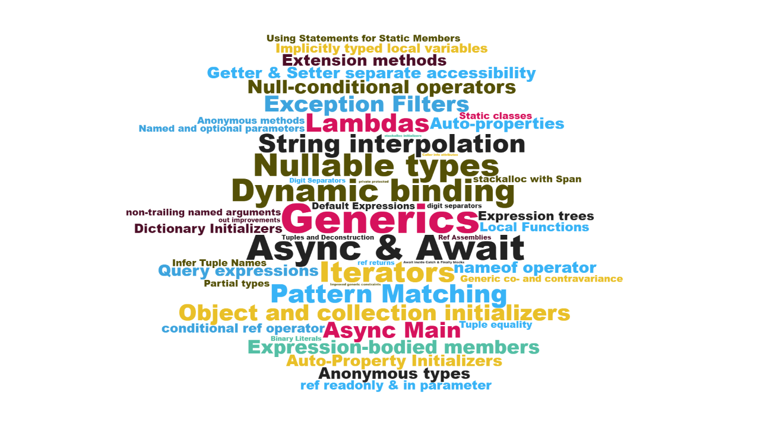

Slide 4
C# 9.0
Records
Init only setters
Top-level statements
Pattern matching enhancements
Target-typed new expressions
Native sized integers
Function pointers
Suppress emitting localsinit flag
static anonymous functions
Target-typed conditional expressions
Covariant return types
Extension GetEnumerator support for foreach loops
Lambda discard parameters
Attributes on local functions
Module initializers
New features for partial methods
https://github.com/dotnet/roslyn/blob/master/docs/Language%20Feature%20Status.md

Slide 5
Pattern Matching

Slide 6
Matching a type & ”attribute”
if(fruit.GetType() == typeof(Apple) && fruit.Color == Color.Green)
{
var apple = fruit as Apple;
var food = MakeApplePieFrom(apple);
}
C# 1.0 – 6.0
switch(fruit)
{
case Apple apple when apple.Color == Color.Green:
var food = MakeApplePieFrom(apple);
break;
default:
break;
}
C# 7.0

Slide 7
Pattern matching: Switch expression
var result = input switch
{
};
The object you want to create patterns for
@fekberg

Slide 8
Patterns in C#
Type pattern
Positional pattern
Property pattern
Tuple pattern
Relational pattern
Conjunctive “and” pattern
Disjunctive “or” pattern
List pattern
Parenthesized pattern
Negated “not” pattern
Recursive patterns

Slide 9
Demo
Records & Pattern Matching in C# 8 => 12

Slide 10
C# 10.0
Record structs
Improvements of structure types
global using directives
File-scoped namespace declaration
Extended property patterns
Improvements on lambda expressions
Allow const interpolated strings
Allow both assignment and declaration in the same deconstruction
https://github.com/dotnet/roslyn/blob/master/docs/Language%20Feature%20Status.md

Slide 11
C# 10: Inferred Delegate Type (Lambda)
// C# 9.0
Func<string, int> parse =
(string number) => int.Parse(number);

Slide 12
C# 10: Inferred Delegate Type (Lambda)
// C# 9.0
Func<string, int> parse =
(string number) => int.Parse(number);
C# 9.0 requires you to explicitly specify delegate type

Slide 13
C# 10: Inferred Delegate Type (Lambda)
// C# 9.0
Func<string, int> parse =
(string number) => int.Parse(number);
// C# 10.0
var parse = (string number) => int.Parse(number);

Slide 14
C# 10: Attributes in Lambdas
app.MapGet("/",
[FromHeader(Name = "Content-Type")]
string contentType) => { ... }

Slide 15
C# 11.0
More patterns List pattern Slice pattern Span pattern
nameof(parameter)
Cache delegates for static method group
Required properties
required string Name { get; init; }
Raw string literals
Static members in interfaces
UTF-8 string Literals
ReadOnlySpan<byte> span = "Filip Ekberg"u8;
Generic math support
Generic attributes
[ThisisAGenericAttribute<string>()]
Parameter null-checking (!!) was been withdrawn due to community feedback
Notes:
5-10 min

Slide 16
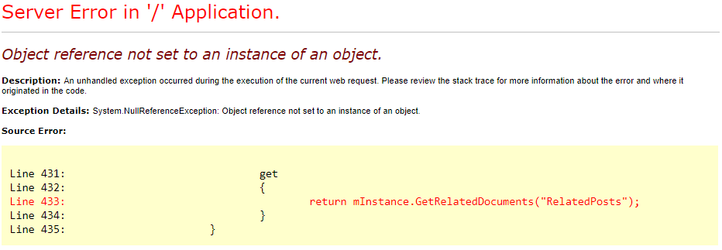
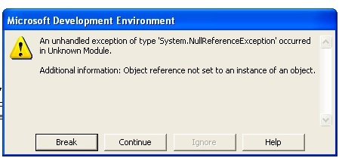
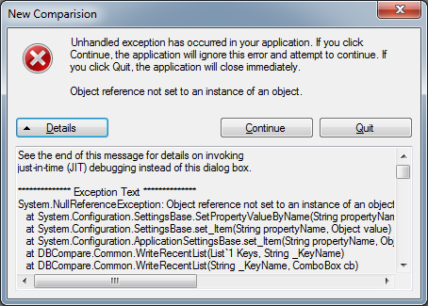
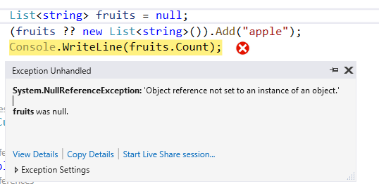
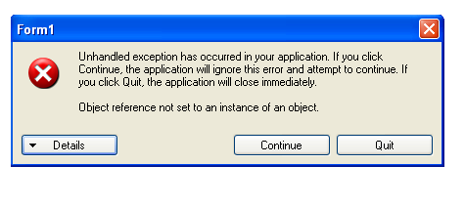

Slide 17
Demo

Slide 18
C# 12.0
Primary constructors
Collection expressions
Inline arrays
Optional parameters in lambda expressions
Ref readonly parameters
Alias any type
Experimental attribute
Interceptors
https://github.com/dotnet/roslyn/blob/master/docs/Language%20Feature%20Status.md
Notes:
15 mins

Slide 19
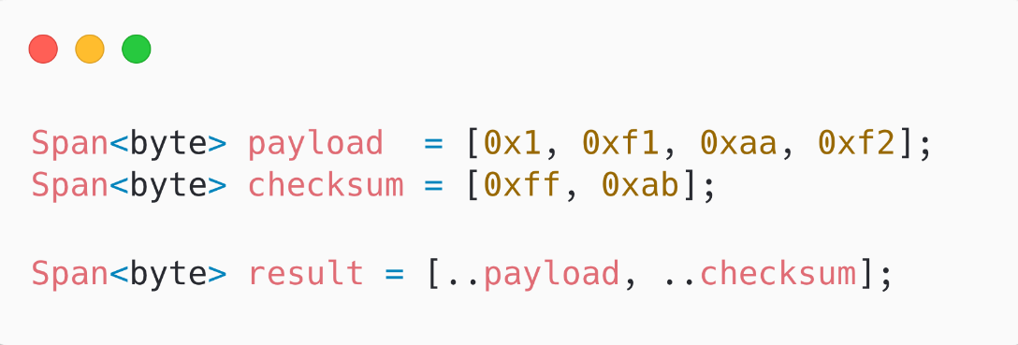
C# 12: Collection Expressions

Slide 20
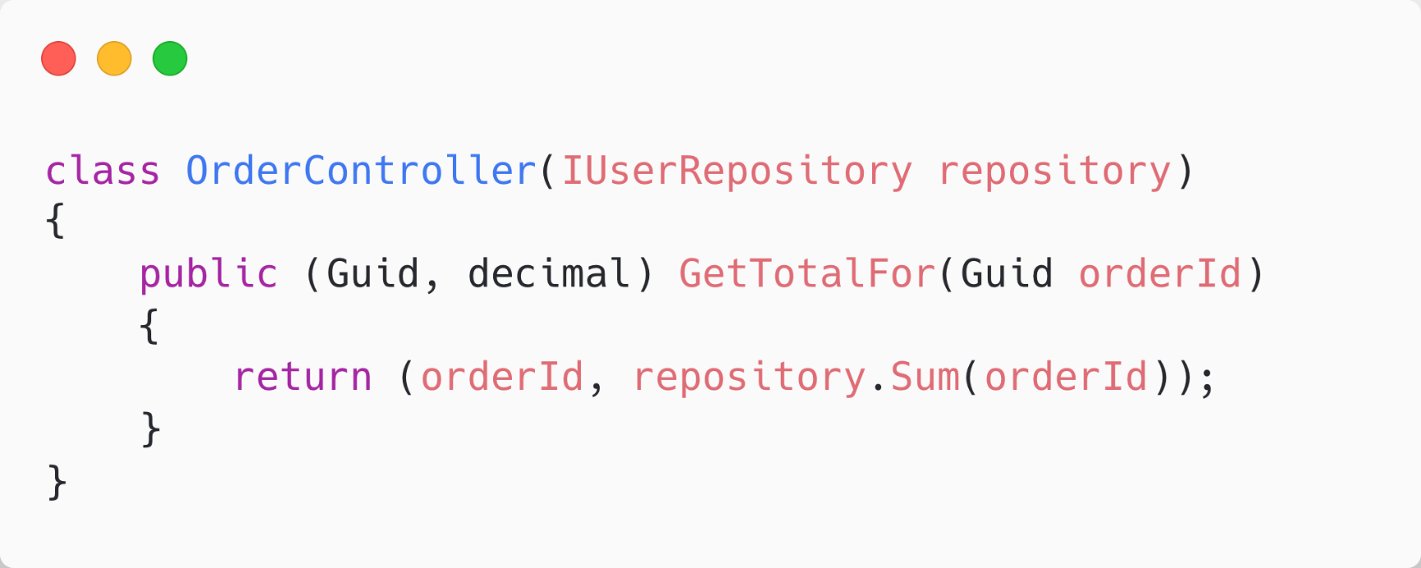
C# 12: Primary constructors

Slide 21
Q & A

Slide 22
Download .NET 8
https://aka.ms/get-dotnet-8

